Slide 1
The Black Box
Control and design of reaction wheel pendulum

Slide 2
Initial thoughts
Inverted pendulum with reaction wheel

Slide 3
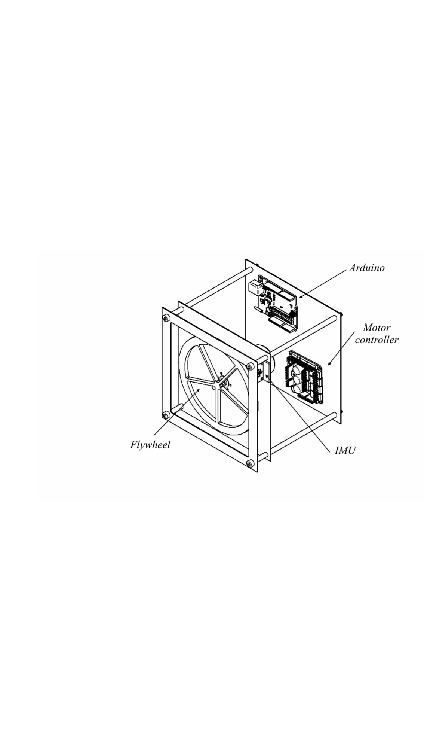
Initial design
Simple construction
IMU
DC-motor
Steel flywheel
Arduino

Slide 4
Research question
What sensor position is least inflicted by noise, when the cube is stationary?
How much does the best and worst position effect the system performance when balancing?

Slide 5
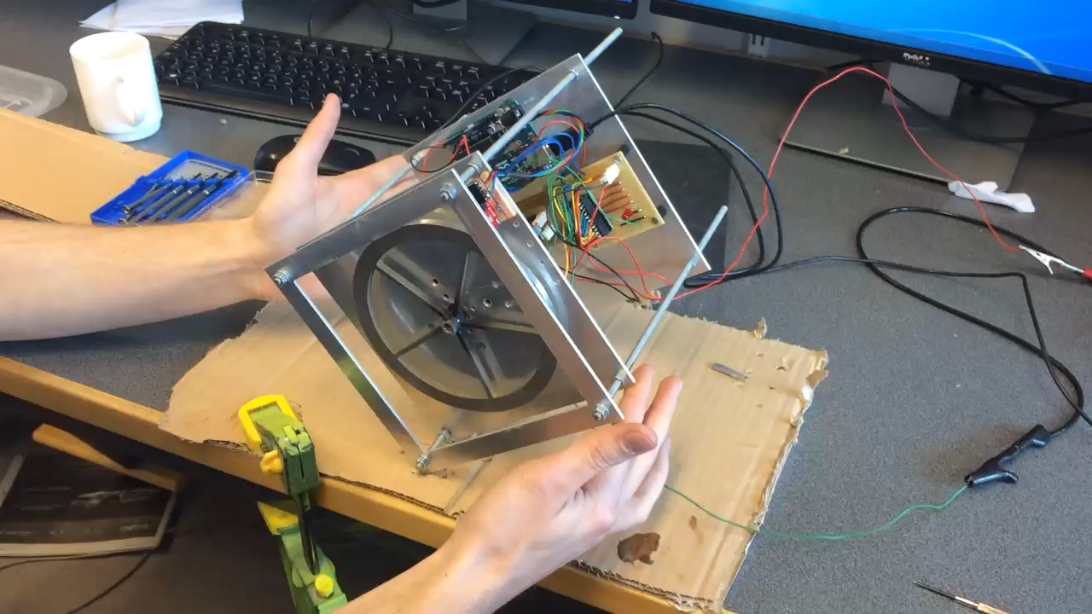
Testing

Slide 6
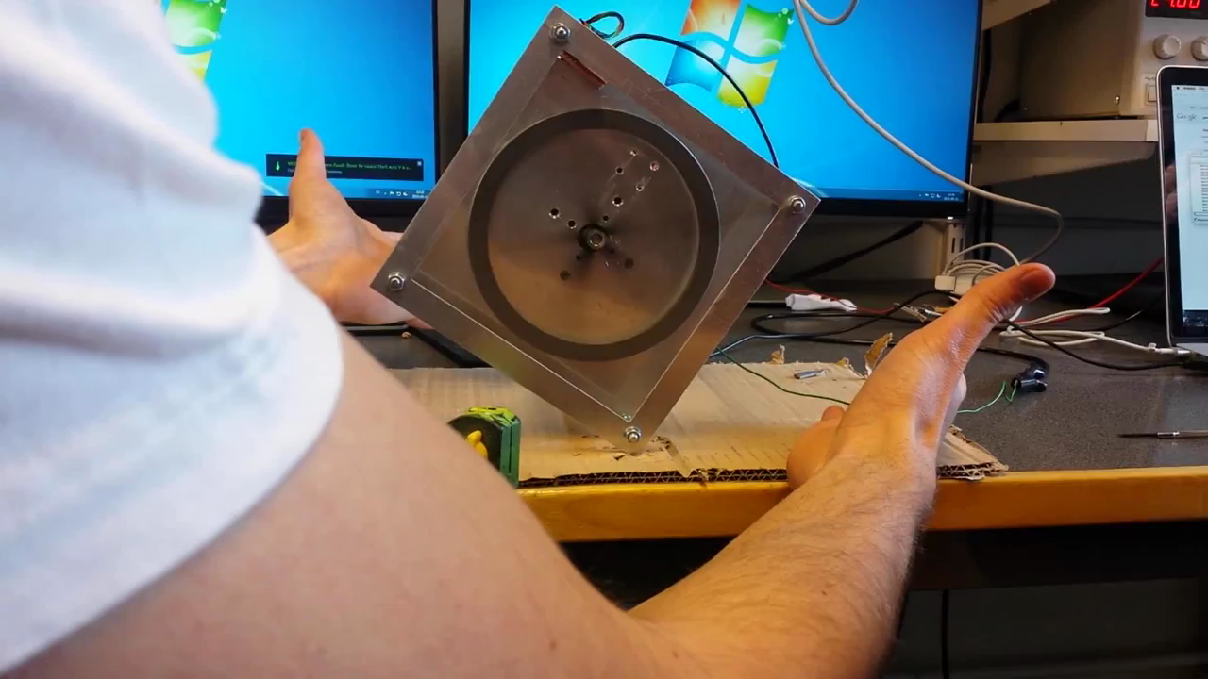
Testing
file:///.file/id=6571367.2867003

Slide 7
Demonstrator results
It doesn’t balance ☹
Hardware limitations Gear Motor Motor controller
Non-discrete control model

Slide 8
Results
Only stationary testing

Slide 9
Conclusions
Motor had negligible effect on the IMU
Structure vibrations effected the IMU more

Slide 10
Questions?

